Slide 1
Data preprocessing of numerical data

Slide 2
Data Science Experiment Flow
Data Pre-processing
Testing
Data Collection
Training
Result Analysis
(Regression)

Slide 3
Task Introduce
A factory machine efficiency analysis problem.
Without any label data and reasonable operation range
Target : analyze data to find out the cause.

Slide 4
Task Introduce
But! Before starting to analyze, we know that outliers is largely influence the regression result.
It is obvious that hand-pick outlier not a good option, so we use some machine learning algorithm to find outliers.

Slide 5
Algorithm | Base on
Box | Statistics
ABOD | Angle-base
CBLOF | Clustering-based
IForest | Ensemble
Feature Bagging | Ensemble
Combine some weak classifier to become a strong classifier

Slide 6
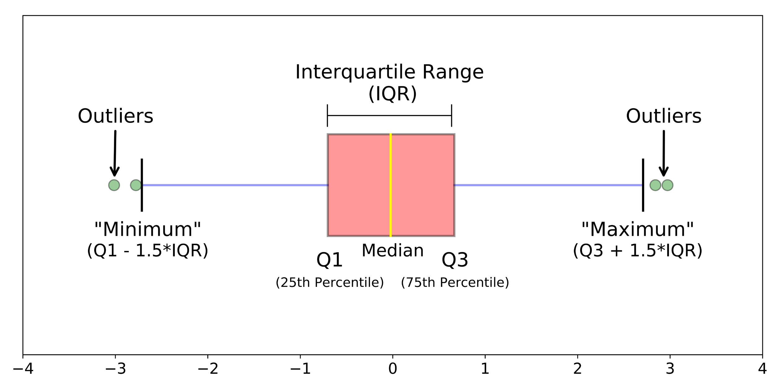

Box
$if x<Q1−1.5×IQR or x>Q3+1.5×IQR, x is outlier$
$IQR=Q3−Q1$

Slide 7
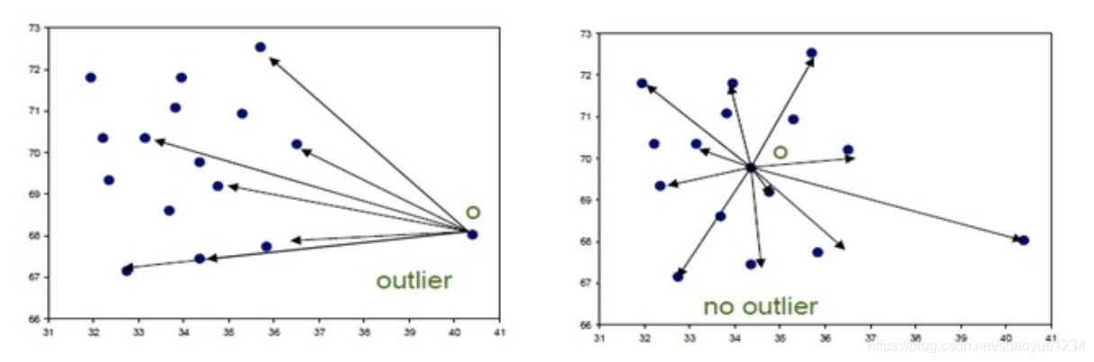
ABOD
Angle-base.
The performance is stable at high dimension.
If most of the points are in the direction A and point X deviates from the cluster in the direction B, then X is an outlier.
If there are many points in different directions, X is not largely different from other, so X is not an outlier.
direction A
direction B

Slide 8
CBLOF
Clustering Based Local Outlier Factor
kNN focus on global anomalies, and CBLOF focus on local anomaly.

Slide 9
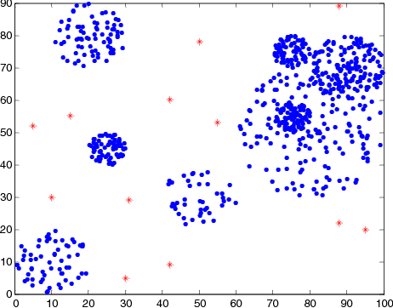
kNN
k-nearest neighbors algorithm.
Result is determined by a "majority vote" of k neighbors.
Depends on the distribution of neighboring points.
The larger the K is, the more noise can be tolerated, while the smaller the K is, the more it is affected by the surrounding abnormal factors.

Slide 10
Ensemble
Iforest
Use multiple independent trees to train.
Result use average of each tree score(distance).
Feature Bagging
Randomly draw and put data back
Train each weak classifier,
Result is determine by voting.

Slide 11
How to evaluate
Each of algorithm base on its rule ( XXX-base) to give their best result…
My proposal is
Calculate the distance between each data
Sort from small to large.
Calculate the average, variance, max and min.

Slide 12
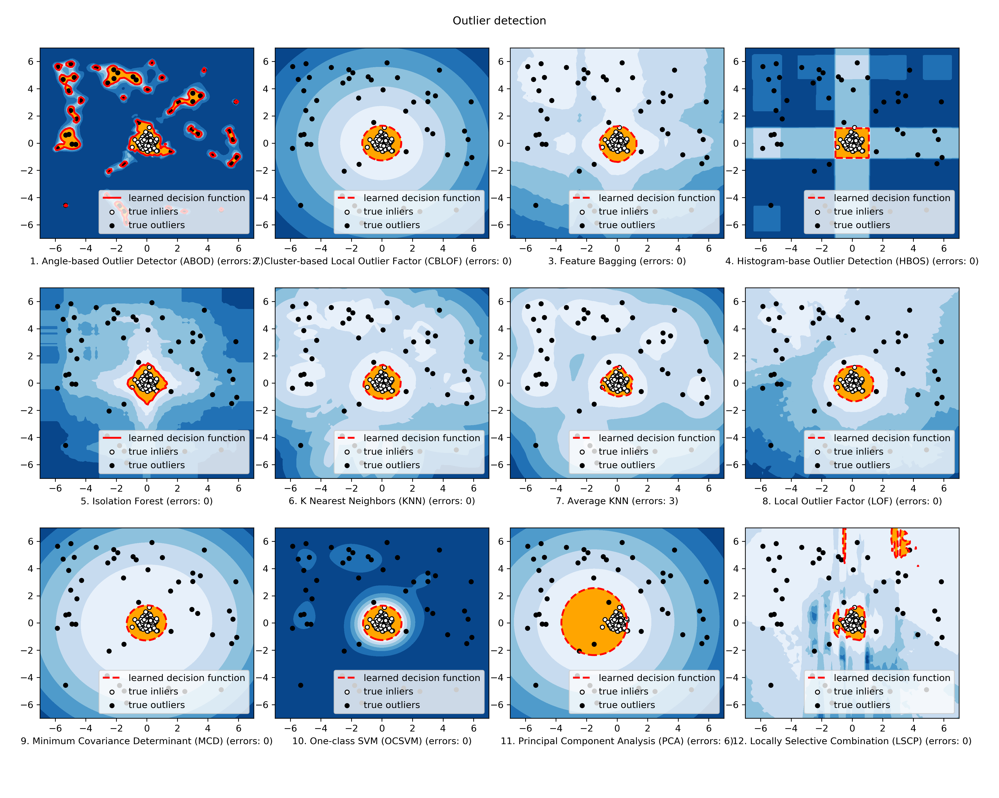
CBLOF
Feature Bagging
HBOS
IForest

Slide 13
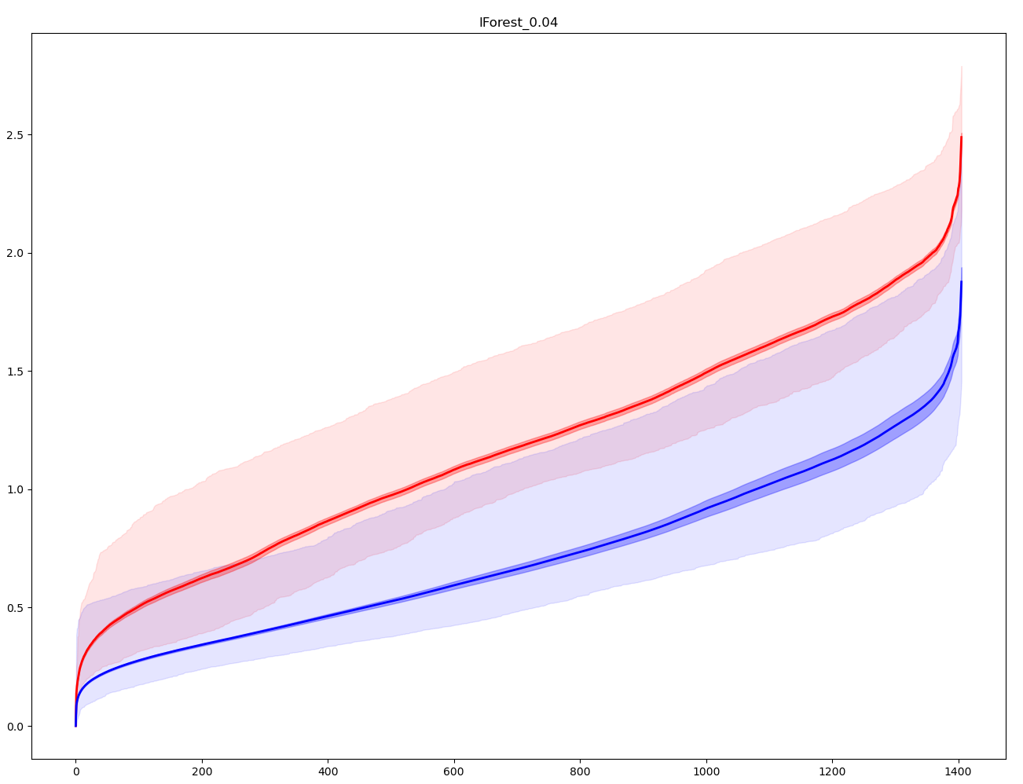
Outlier
Inlier
Average of Distance for all point
Average of Distance for all point

Slide 14
Outlier
Variance of Distance
(Dark shadow)
Max Distance to each point for outlier point.
Inlier
Min Distance to each point for outlier point.
Max Distance to each point for inlier point.
Min Distance to each point for inlier point.
Variance of Distance
(Dark shadow)

Slide 15
Analysis : Outliers
Outliers have low variance and high average than inlier.
Outliers are scattered or just some small clusters and far from inlier.
So each of outliers has a large distance which make average high and low variance.

Slide 16
Analysis : Inliers
Average of inlier is far from outlier, that is good.
Max of distance of inlier is lower than average of outlier
➔ Inlier and outlier is very separate.

Slide 17
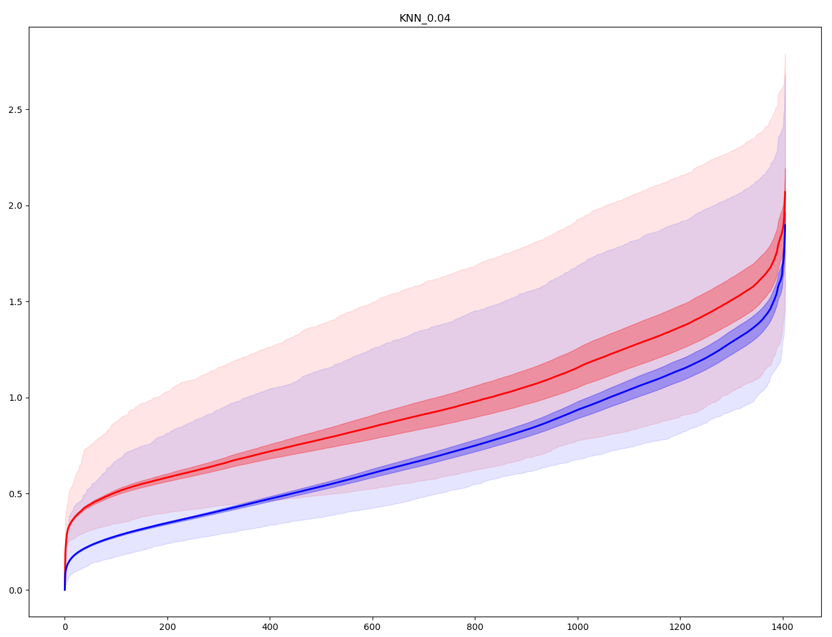
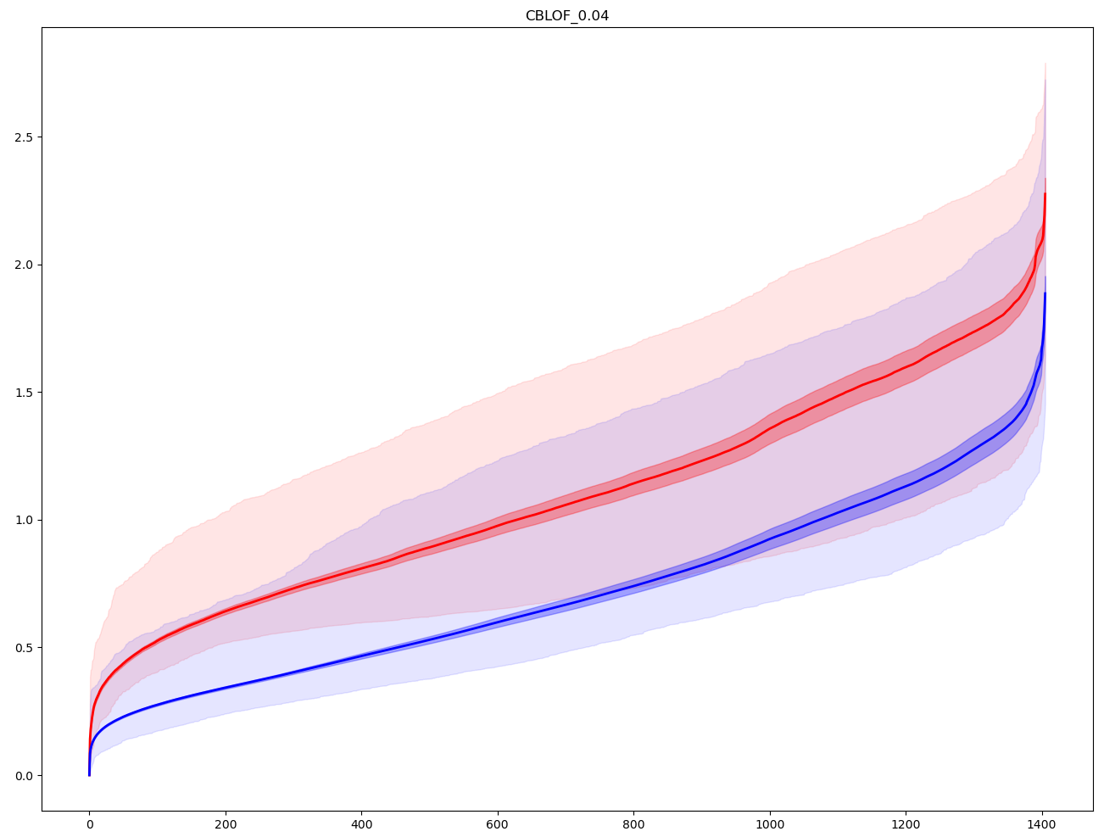
Compare
IForest
kNN
CBLOF

Slide 18
Thank you for listening.
Hope my report is helpful to you!

